Slide 1

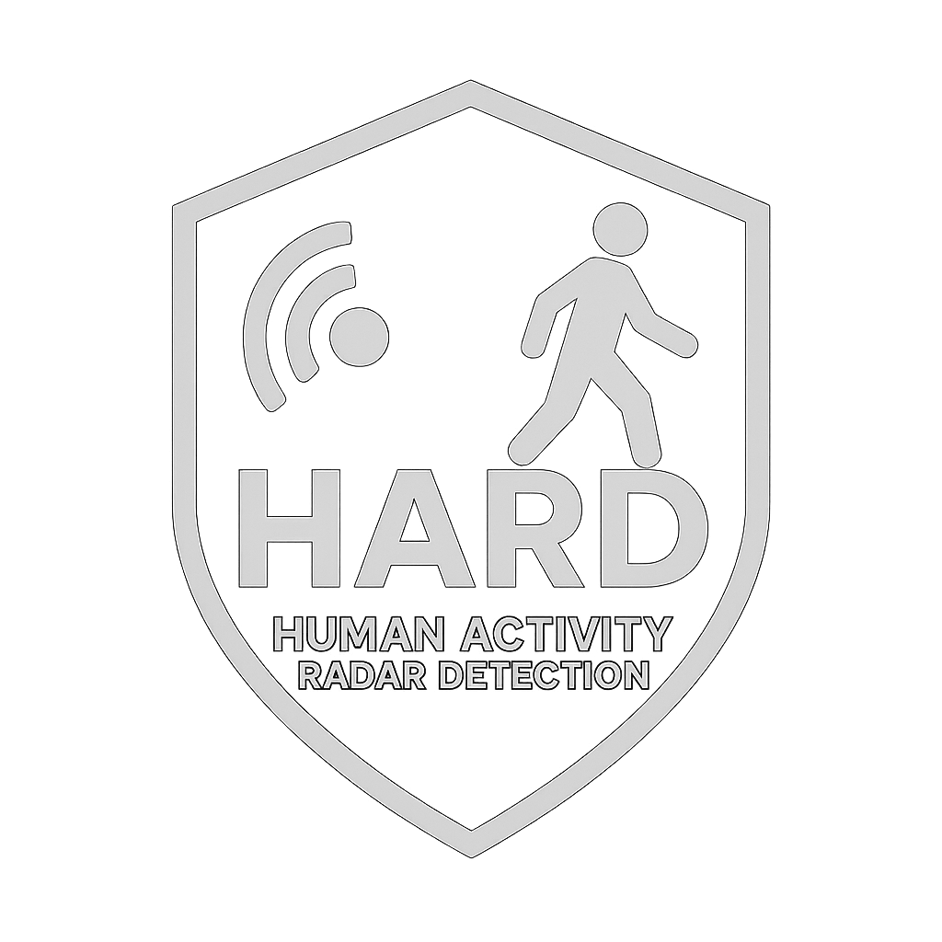
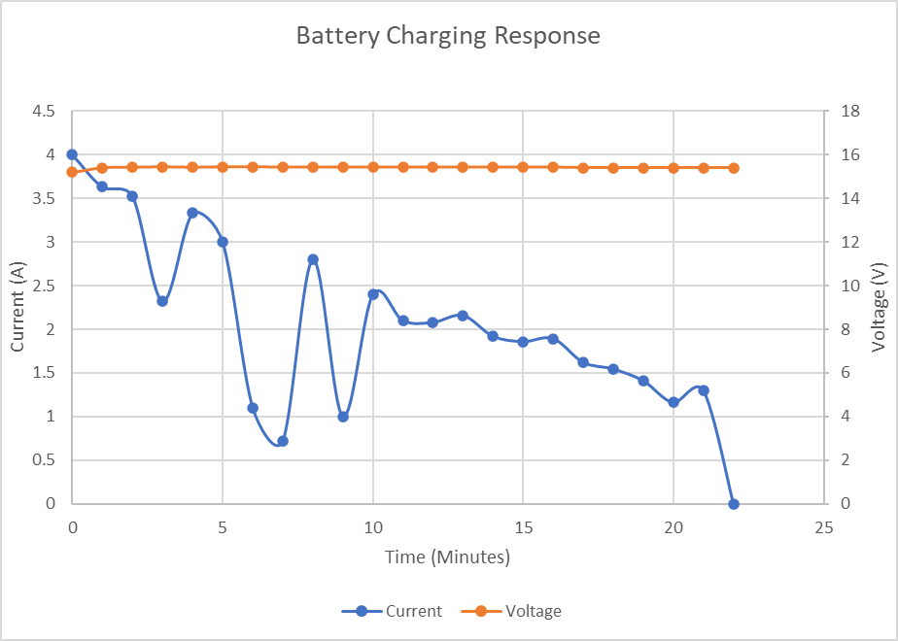
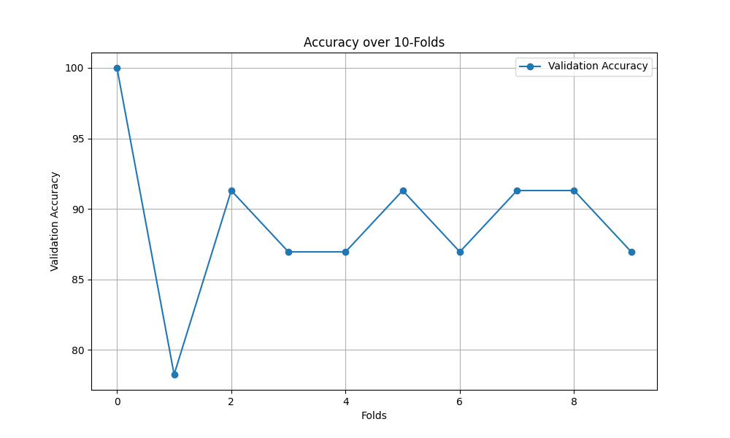
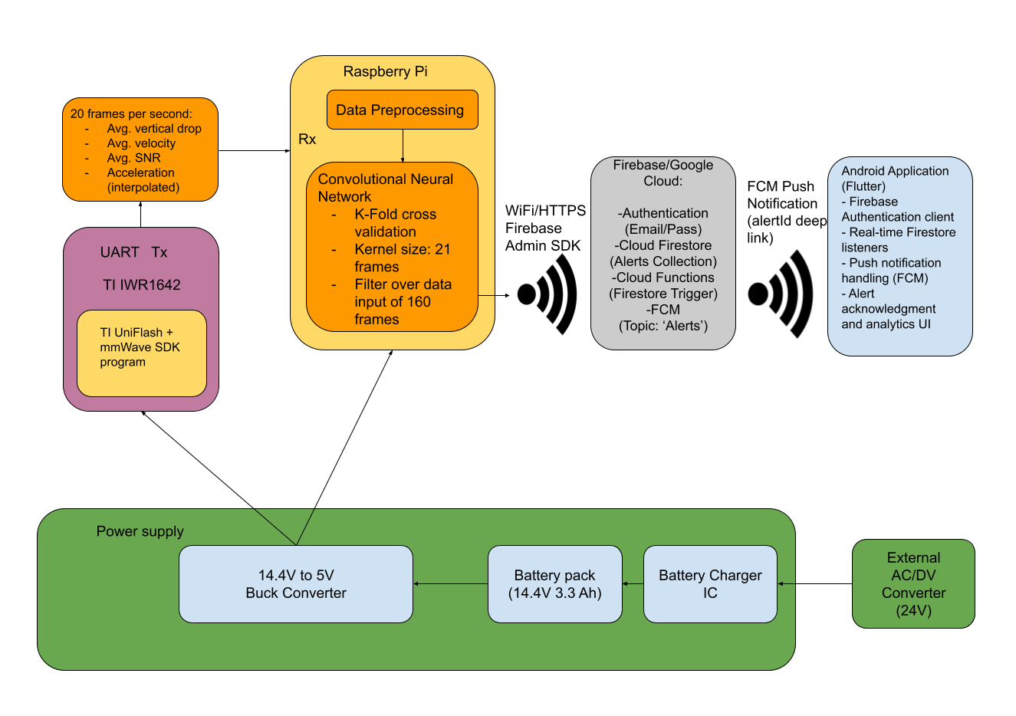
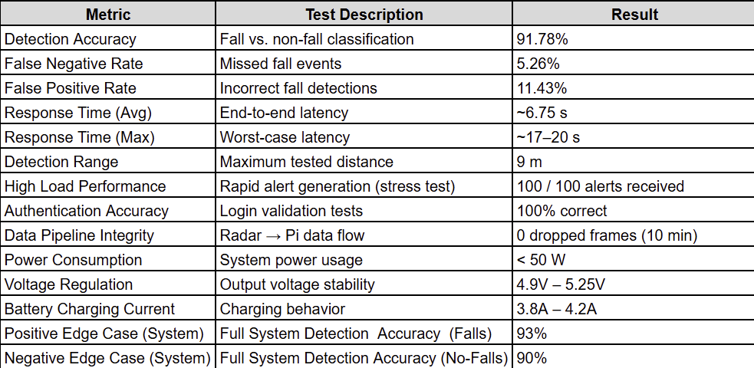
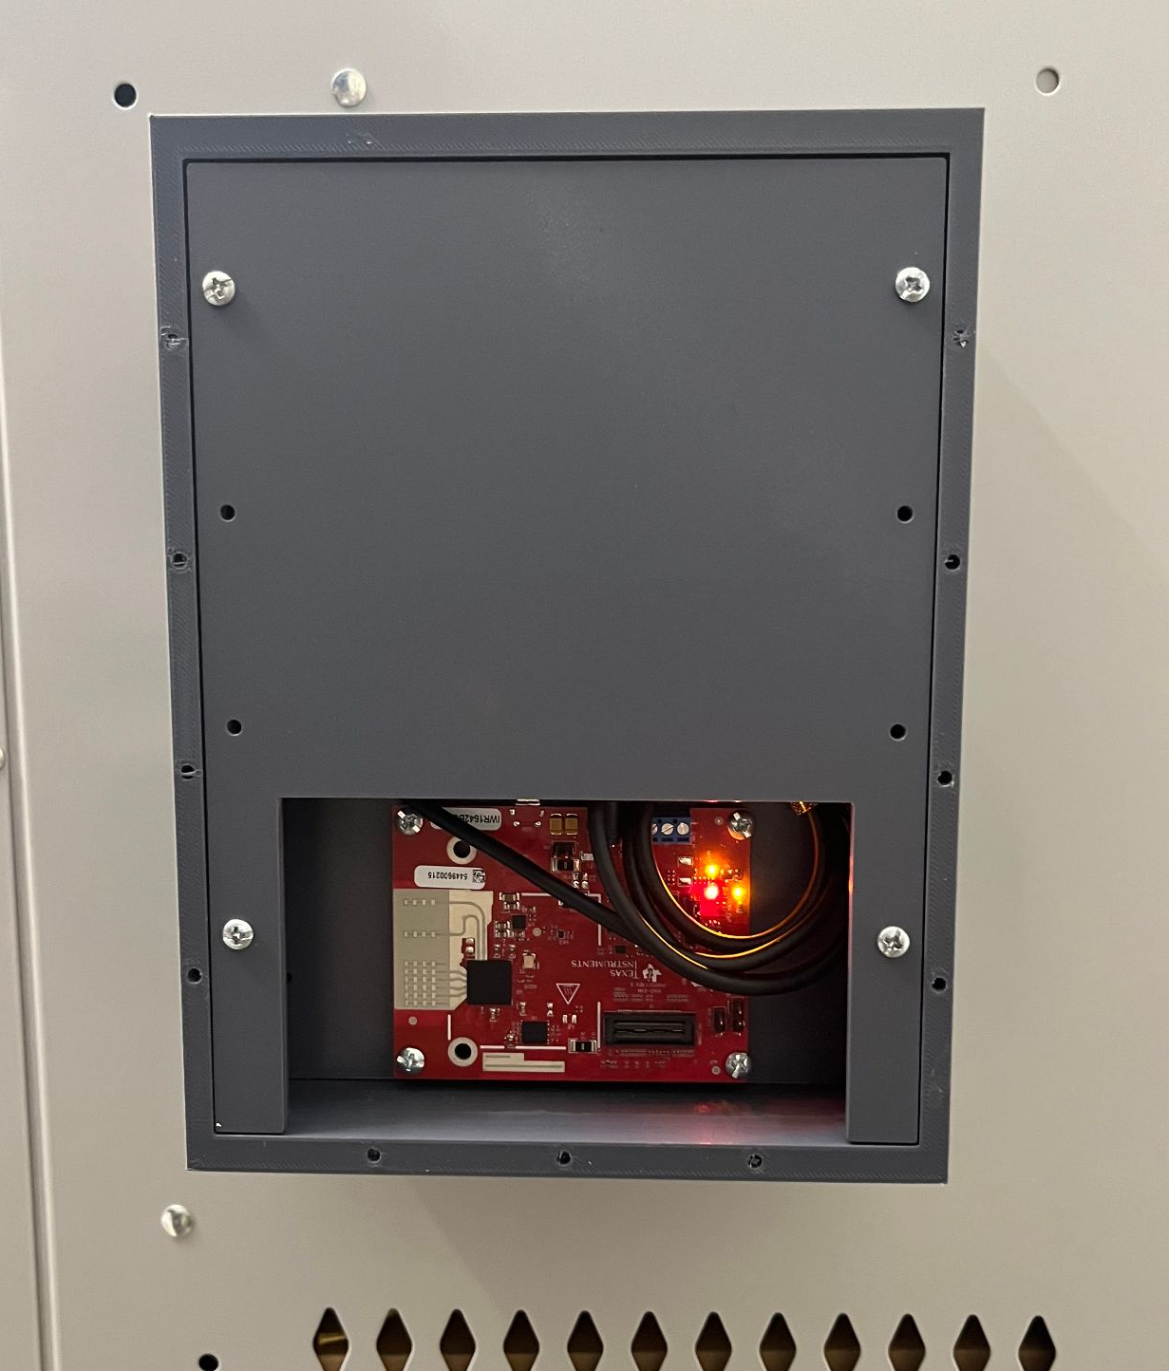
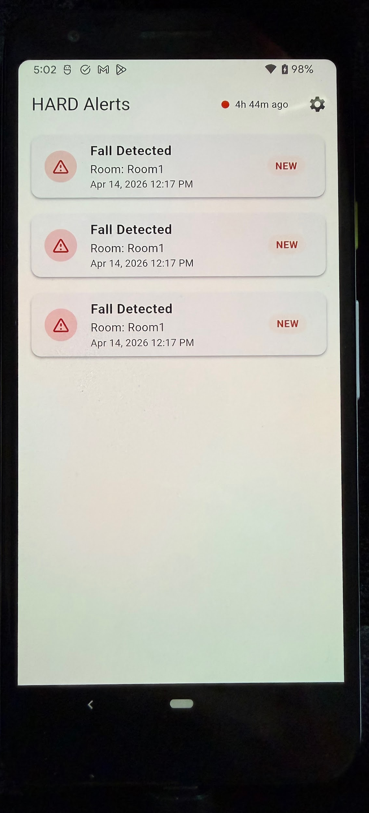
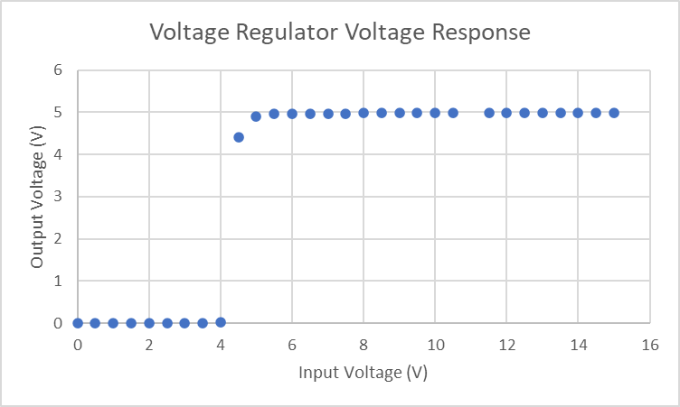
Human Activity Radar Detector William Jachimiak, Jean Jacques Chirat,
Preston Bowyer, Aiden George Sponsor: Dr. Arya Menon
Problem Definition
Falls in residential and assisted living environments are a leading cause of injury and often go undetected in real time.
Existing solutions such as wearables and cameras suffer from low user compliance, privacy concerns, or unreliable detection performance.
This project aims to develop a non-invasive, radar-based fall detection system that integrates sensing, embedded processing, machine learning, power systems and cloud-connected alerting to provide reliable, real-time notification to caregivers.
Methodology
• Radar Subsystem: Captures raw motion data using mmWave radar and interfaces the data with ML and App subsystems
• Machine Learning Subsystem: Trained classification model to distinguish fall vs non-fall events using processed radar data
• Power Subsystem: Designed and validated battery powered stable voltage regulation for continuous system operation while charging batteries
•End-User App Subsystem: Provides real-time alert visualization, user interaction, and system monitoring through a mobile interface, with alert acknowledgment, historical data analysis, and device status tracking via cloud integration
• System Integration:
Engineering Analysis
• Data Processing Pipeline: Evaluated preprocessing and feature extraction pipeline to ensure consistent, low-noise inputs to the ML model
• Machine Learning Performance: Tested classification behavior across labeled fall/non-fall events Analyzed prediction accuracy, confidence levels, and misclassification cases
• End-to-End System Latency: Measured total time from physical event → radar capture → ML inference → cloud transmission → mobile display
• System Load Testing: Simulated high-frequency alert generation to evaluate system throughput and stability under stress conditions
• Power System Stability: Verified consistent voltage/current delivery and continuous system operation under sustained runtime
• Data Integrity & Backend Processing): Verified correct ingestion, storage, and retrieval of alert data across the backend pipeline
Outcomes
• Detection Performance: ~91% accuracy across 73+ controlled test cases Reliable distinction between fall and non-fall events
• System Response Time: Alert delivery consistently under 20 seconds Average response time: ~6.75 seconds
• High Load Reliability: Successfully processed 100 alerts in rapid succession 0 dropped alerts with no system degradation
• Communication Stability: Reliable data transmission from device to cloud across repeated trials. Maintained operation under continuous request cycles
• Power System Performance: Stable operation during four hour runtime
• User Authentication: 100% correct acceptance/rejection across test cases.
• Device Monitoring: System accurately detects device online/offline status.
• User Interface Functionality: Fully operational mobile app including: Real-time alerts, alert acknowledgment, historical analytics and trend visualization
Impact
• Provides a privacy-preserving alternative to camera-based monitoring
• Enables real-time fall detection without wearable dependency
• Demonstrates integration of hardware sensing, ML inference, and cloud systems
• Scalable for deployment in elder care, hospitals, and assisted living environments
References
“MMWAVE-SDK Software Development Kit (SDK) | TI.com.”
Ti.com, 2022, www.ti.com/tool/MMWAVE-SDK.
Shao L, Shi Y, Xie XY, Wang Z, Wang ZA, Zhang JE.
Incidence and Risk Factors of Falls Among Older People
in Nursing Homes: Systematic Review and Meta-Analysis. J Am Med Dir Assoc. 2023 Nov 24(11):1708-1717. doi: 10.1016/j.jamda.2023.06.002. Epub 2023 Jul 8. PMID: 37433427.
Acknowledgments
Special thanks to Dr. Arya Menon, Dr. John Lusher, Roman Venegas, and Manoj Kumar Balamurugan.

